Slide 1
Litman Gregory Masters Alternative Strategies Fund MASFX / Institutional MASNX / Investor
DISTINCTIVE SOLUTIONS
TO CHALLENGING ASSET CLASSES
This information is authorized for investment advisors, broker/dealers, and other registered financial professionals only.

Slide 2
DISCLOSURE
Each fund’s investment objectives, risks, charges, and expenses must be considered carefully before investing. The prospectus and summary prospectuses contain this and other important information about the investment company, and it may be obtained by calling (800) 960-0188, or visiting www.mastersfunds.com. Please read it carefully before investing.
Mutual fund investing involves risk. Principal loss is possible. Diversification does not assure a profit nor protect against loss in a declining market.
References to other mutual funds should not be deemed an offer to sell or solicitation of an offer to buy shares of such funds.
Litman Gregory Fund Advisors LLC has ultimate responsibility for the performance of the Masters Funds due to its responsibility to oversee the investment managers and recommend their hiring, termination and replacement.
Multi-investment management styles may lead to higher transaction expenses compared to single investment management styles. Outcomes depend on the skill of the sub-advisors and advisor and the allocation of assets amongst them.
Each of the funds may invest in foreign securities. Investing in foreign securities exposes investors to economic, political, and market risks and fluctuations in foreign currencies. Each of the funds may invest in the securities of small companies. Small-company investing subjects investors to additional risks, including security price volatility and less liquidity than investing in larger companies. The International Fund will invest in emerging markets. Investments in emerging market countries involve additional risks such as government dependence on a few industries or resources, government-imposed taxes on foreign investment or limits on the removal of capital from a country, unstable government, and volatile markets. The Alternative Strategies Funds will invest in debt securities. Investments in debt securities typically decrease when interest rates rise. This risk is usually greater for longer-term debt securities. Investments in mortgage-backed securities include additional risks that investor should be aware of including credit risk, prepayment risk, possible illiquidity, and default, as well as increased susceptibility to adverse economic developments. Investments in lower-rated and non-rated securities present a greater risk of loss to principal and interest than higher-rated securities. The Alternatives Strategies Fund will invest in derivatives. Derivatives may involve certain costs and risks such as liquidity, interest rate, market, credit, management, and the risk that a position could not be closed when most advantageous. Investing in derivatives could lose more than the amount invested. The Alternative Strategies Fund may make short sales of securities, which involves the risk that losses may exceed the original amount invested. Merger arbitrage investments risk loss if a proposed reorganization in which the fund invests is renegotiated or terminated. The Alternative Strategies fund may employ leverage. Leverage may cause the effect of an increase or decrease in the value of the portfolio securities to be magnified and the fund to be more volatile than if leverage was not used.
Litman Gregory Masters Funds are distributed by ALPS Distributors Inc.
LGM000457 exp. 7/26/2017

Slide 3
DISCLOSURE
Investment in absolute return strategies are not intended to outperform stocks and bonds during strong market rallies.
The Morningstar percentile ranking is based on the fund's total-return percentile rank relative to all funds that have the same category for the same time period. The highest (or most favorable) percentile rank is 1%, and the lowest (or the least favorable) percentile rank is 100%. Morningstar total return includes both income and capital gains or losses and is not adjusted for sales charges or redemption fees.
The Morningstar Fund Manager of the Year award recognizes fund managers who had a good calendar year, have blazed a trail with original research and who stick to their strategies through thick and thin, and are good stewards, putting fund holders' interests first rather than trying to extract every last penny from shareholders. Morningstar selects leaders in three asset classes—domestic stock, international stock, and fixed-income. Morningstar’s fund analysts select the Fund Manager of the Year award winners based on Morningstar’s proprietary research and in-depth evaluation.
(c) 2016 Morningstar, Inc. All Rights Reserved. The information contained herein: (1) is proprietary to Morningstar; (2) may not be copied or distributed; and (3) is not warranted to be accurate, complete or timely. Neither Morningstar nor its content providers are responsible for any damages or losses arising from any use of this information. Past performance is no guarantee of future results.

Slide 4
TWO SIMPLE PREMISES: DRAWING ON OVER 25 YEARS OF LITMAN GREGORY RESEARCH DUE DILIGENCE
1. We believe experienced, world-class investment managers are likely to outperform passive benchmarks over the long term.
2. We believe portfolios comprised of these skilled investment managers’ highest-conviction ideas are likely to outperform their more-diversified, lower active-share portfolios over the long term.

Slide 5
OUR BELIEFS: KEY TENETS
Skilled investment managers exist and we believe we can identify them.
We believe a concentrated portfolio of an investment manager’s highest-conviction ideas will outperform a broader portfolio over the long term.
Combining investment managers with differing approaches provides diversification at the fund level.
We can create an environment that provides managers with the flexibility and confidence to execute on their most compelling ideas with minimal constraint and a focus on differentiation.

Slide 6
DESIGNED AS STRATEGIC SOLUTIONS TO CHALLENGING ASSET CLASSES
Litman Gregory Masters Funds Core Offerings With Institutional Shares
Highly respected managers whom we believe to be the best in their strategy
Multi-manager structure provides diversification in investment style and strategy
Alternative Strategies Fund (MASFX) | International Fund (MSILX) | Smaller Companies Fund (MSSFX)
Core offering that seeks to beat 40/60 stock/bond mix over the long term, at potentially lower volatility | 15-year+ track record of strong relative performance (ranks in the top 20% by Morningstar among 224 foreign large blend funds based on total return for the 15-years ending 6/30/16) ² | Currently open capacity in a highly constrained investment category
Complementary yet flexible alpha-focused strategies provide diversification and low correlation | 3 Morningstar® International Managers of the Year³ | Individual sub-advisor concentration focusing on 8 to 15 highest-conviction ideas
Low relative cost, fully liquid and transparent strategies¹ | Individual sub-advisor concentration focusing on 8 to 15 highest-conviction ideas | Compelling historical MPT statistics
Absolute-return and risk management focus | Core, diversified international equity strategy | Core small-cap blend strategy
¹See slide 33 for expense information
²Based on total returns over 1, 3, 5, 10, & 15 years through 6/30/16, the International Fund ranked in the top 98%, 94%, 89%, 31%, & 20% for each period among 823, 720, 631, 380, & 224 foreign large blend funds respectively.
³Awards not related to management of MSILX

Slide 7
DIFFERENTIATING TRAITS OF OUR SUB-ADVISORS
Disciplined investment processes with an identifiable investment edge
Experienced, intelligent and skillful
Passionate about investing and committed to the Litman Gregory Masters Funds concept
Confident , intellectually honest and independent thinkers

Slide 8
KEY DIFFERENTIATORS
Distinctive portfolios created by investment managers who run these individualized sleeves for Litman Gregory – these are not funds of funds
Portfolios cannot be replicated by “building” a comparable mix of funds run by these investment managers off the shelf
High-conviction, high-active-share portfolios at manager and aggregate portfolio level
Broader diversification at the overall fund level in terms of number of positions, investment approach, and market capitalization

Slide 9
FOUNDATION OF THE PARTNERSHIPS BETWEEN LITMAN GREGORY & THE MASTERS SUB-ADVISORS
LONG-TERM RELATIONSHIPS
Our relationships with the managers pre-date their tenure on the funds. We have invested with many of them for over 20 years, and they respect our research, due diligence, and rational, long-term approach to investing.
INTELLECTUAL CHALLENGE
Managing a concentrated portfolio requires a sharp focus on stock selection; many managers have told us they welcome the challenge of managing a Litman Gregory Masters portfolio, and the experience has improved their own investment process.
STRUCTURAL ADVANTAGE
Independently managing a concentrated portfolio within a multi-manager structure frees the managers from many portfolio construction constraints and allows them to pursue their highest-conviction ideas.

Slide 10
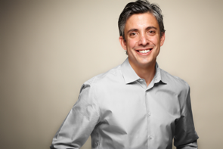
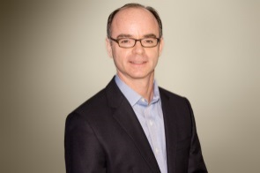
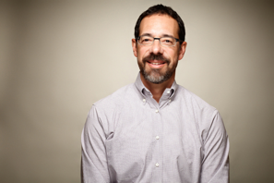
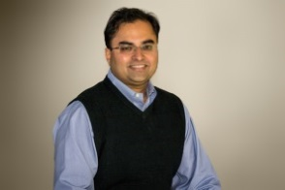
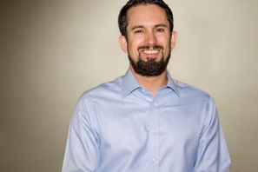
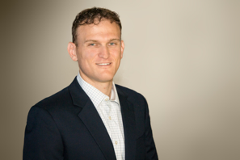
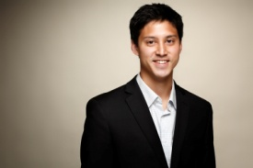
LITMAN GREGORY CORE RESEARCH TEAM
JACK CHEE Principal, Sr. Research Analyst | JEREMY DEGROOT, CFA Principal, Chief Investment Officer | KEN GREGORY Co-Founding Principal | RAJAT JAIN, CFA Principal, Sr. Research Analyst | JASON STEUERWALT, CFA Sr. Research Analyst | ALISTAIR SAVIDES, CFA Research Analyst | KIKO VALLARTA Research Analyst
18 years of investment experience | 25 years of investment experience | 35 years of investment experience | 18 years of investment experience | 16 years of investment experience | 10 years of investment experience | 8 years of investment experience
Manager due diligence focusing on domestic equity and fixed-income, asset-class coverage of fixed-income and REIT markets | Oversight of asset class research, tactical allocation, and manager due diligence with specialization in alternatives | Founder of the funds and president of Litman Gregory Fund Advisors | Manager due diligence focusing on domestic and international equity, asset-class coverage of domestic and international markets | Research focus: Fixed income, alternative strategies | Responsible for investment research and analytical support across Litman Gregory’s asset class and manager research capabilities | Responsible for investment research and analytical support across Litman Gregory’s asset class and manager research capabilities
Previously with Value Line Mutual Fund Survey | Previously with KPMG Peat Marwick and Sr. Economist with Law & Economics Consulting Group | Previously with Bank of America Executive Financial Counseling Group and President of Williams Asset Management | Previously with Montgomery Asset Management and Associate Director with BARRA Rogers Casey | Previously with Hall Capital Partners | Previously with the Principia Corporation’s endowment fund and StraightLine | Previously with Financial Designs, Ltd
Drexel University (BS - Mechanical Engineering) | University of Wisconsin (BS – Economics); University of California – Berkeley (MA – Economics) | University of the Pacific (BA - Business); University of Michigan (MBA) | St. Stephen’s College (BS – Physics); University of South Carolina (MBA – International) | Brown University (BA – Economics, Political Science) | Principia College (BA – Economics, and International Relations); Haas School of Business (MBA) | San Diego State University (BS–Finance); St. Mary’s College of California (MS–Financial Analysis and Investment Management)

Slide 11
LITMAN GREGORY CORE RESEARCH TEAM
History since firm inception of specialized manager due diligence
Thoughtful and thorough research
Long-term investment horizon
Flexible and innovative thinking
Respect for differentiated investment process
Shareholder orientation
Risk-aware, alpha-driven mentality

Slide 12
DEVELOPING AND MAINTAINTING A SUSTAINABLE EDGE WITH IN-DEPTH, ON-GOING DUE DILIGENCE PROCESS
From overall portfolio positioning to understanding the conviction behind specific holdings and strategies, we are always deeply analyzing the ‘why and how?’
Criteria We Look For:
IDENTIFYING AND SELECTION
MONITORING AND MANAGING
Available universe analysis and robust quantitative screening process
CRITERIA WE LOOK FOR:
Disciplined Approach
Comfort with Concentration
Obsessive in Seeking an Edge
Focus
Organizational Quality
Quality Team and Culture
Define investment guidelines
Continuously monitor portfolios, reassessing and reaffirming via hands-on understanding and updating of holdings and positioning, strategic thinking, investment theses, attribution and performance compared to appropriate benchmarks
In-depth due diligence:
questionnaires, multiple interviews,
historical analysis, site visits, test portfolios
A select few make the final cut: managers with a sustainable edge
Maintain constant communications

Slide 13
ALTERNATIVE STRATEGIES FUND INCEPTION
PROBLEM:
Few compelling options.
Our due diligence into alternative strategies lasted several years.
Cast a wide net in our search.
Found few compelling options due to:
High costs
Lack of liquidity
Lack of track record
No clear investment edge, questionable quality
SOLUTION:
We created our own.
Drew on our expertise in manager due diligence.
Looked for skilled, risk-conscious managers who:
Ran strategies we believed to be low risk and not closely correlated with financial assets (esp. stocks) or
Invested in situations that they believed to be highly asymmetric (emphasizing capital preservation with upside potential)
Sought out strategies that were clear and compelling:
Not driven by the same risk factors
Complementary to each other
Created a diversified multi-strategy alternatives fund:
Cost-effective
Transparent, understandable, with daily liquidity
Seeks to provide attractive returns with diversification benefits, reduced risk and lower volatility to stock and bond market indexes.

Slide 14
RISK/RETURN TARGETS
The fund seeks to achieve the following goals:
Returns over a full market cycle that are significantly higher than the three-month LIBOR rate and better than a 40/60 stock/bond mix
Volatility in the range of 4%-8%
Relatively low correlation to traditional stock and bond indexes
Although the managers actively manage risk to reduce portfolio volatility, there is no guarantee that the fund will always maintain its targeted risk level, especially over shorter time periods and loss of principal is possible. The performance goals are not guaranteed, are subject to change and should not be considered a predictor of investment return. All investments involve the risk of loss and no measure of performance is guaranteed. The fund aims to deliver its return over a full market cycle, which is likely to include periods of both up and down markets.

Slide 15
ALTERNATIVE STRATEGIES FUND
The Litman Gregory Masters Alternative Strategies Fund combines skilled managers with distinct, risk-averse strategies that are compelling individually and, in our view, bring a diversification benefit to a broader stock-bond portfolio.
The underlying strategies are transparent, the managers are well-established, and the fund offers benefits of daily liquidity, below-average expenses relative to its peers, and the oversight and due diligence expertise of a firm with more than 25 years experience in manager research.
PASSPORT CAPITAL
Long-Short Equity
FIRST PACIFIC ADVISORS
Contrarian Opportunity
WATER ISLAND CAPITAL
Arbitrage Strategy
LOOMIS SAYLES
Absolute-Return Fixed-Income
DOUBLELINE CAPITAL
Opportunistic Income
LITMAN GREGORY

Slide 16
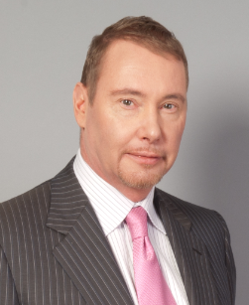
OPPORTUNISTIC INCOME GUNDLACH / DOUBLELINE
Private hedge fund strategy Litman Gregory invested in previously
Invests in best-idea fixed-income securities, with focus on the mortgage sector, where DoubleLine has particularly strong expertise
Invests tactically in other fixed-income sectors and asset classes when he believes potential absolute-return and/or relative-return opportunities (compared to mortgage sector) are compelling
Analyzes and identifies fixed-income securities that he believes offer greater potential payoff than loss under multiple scenarios
Employs a risk integration process seeking to combine assets that he believes perform differently in disparate scenarios so that overall portfolio risk/reward profile is acceptable in a variety of scenarios
May use leverage to a limited extent
Opportunistic Income
Strives to deliver positive absolute returns that are meaningfully in excess of the Barclays U.S. Aggregate Bond Index with potential for lower portfolio volatility (based on standard deviation)

Slide 17
OPPORTUNISTIC INCOME GUNDLACH / DOUBLELINE
Broad Opportunity Set
With Core Exposure to Mortgage-Backed Securities
DoubleLine’s portfolio management team believes the most reliable way to enhance returns is to exploit inefficiencies within the subsector of the fixed income market while maintaining active risk management constraints.
Implementation of portfolio asset allocation decisions are made by experienced teams for each asset class incorporating their research. These portfolio managers purchase securities within their respective sectors under an integrated risk management framework overseen by the DoubleLine risk management team.
This investable universe is for illustrative purposes only and does not represent actual asset allocation breakdown. Weightings across sectors will vary and may not be equally weighted. It is possible that the portion of the Fund managed by DoubleLine can be 100% invested in mortgage backed securities.

Slide 18
OPPORTUNISTIC INCOME GUNDLACH / DOUBLELINE
INVESTMENT PROCESS
Economic Discussions
Top-Down
Investment Outlook
Top-Down & Bottom-Up
Implementation
Bottom-Up
Macroeconomic & Market
Sector Analysis
Interest rates, yield curve, spreads, credit, and general analysis of the markets discussed:
Frequent discussions on the trading desk, led by Jeffrey Gundlach
Research team contributes market analysis including originator and servicer research, unemployment data, housing market trends, government legislation, etc.
Portfolio managers provide input on subsector analysis
Identify subsector with potential alpha generation
Qualitative Analysis
Evaluate market trends and portfolio analytics
Reaffirm opportunistic subsectors
Assess portfolio risks
Duration, convexity decisions
Asset allocation decision process
Research: loan-level analysis including delinquencies, defaults, severity/recovery rates, and other drivers of valuation
Team-based decision with Jeffrey Gundlach normally making final allocation and policy changes
Portfolio Management/ Quantitative Process
Consult portfolio guidelines
Responsible for security selection based on “stress testing” analysis evaluating security characteristics under those possible scenarios
Several portfolio managers run simultaneous analysis and compare results
Daily Monitoring of risk through customized summary reports

Slide 19
CONTRARIAN OPPORTUNITY FPA / ROMICK, SELMO, LANDECKER
Have a risk-averse focus on absolute value, not relative value, seeking equity-like returns over longer periods (5 to 7 years) while protecting against loss of capital
Take advantage of high-conviction, mispriced ideas
Long history of running private hedge fund that Litman Gregory invested in
Invest globally, and across a company’s capital structure, as well as in less-liquid asset classes, such as real estate related securities, whole mortgage loans, and small-cap foreign securities
Seek investments that are attractive on an absolute risk-return basis - not just cheap relative to the market or peer group. Thus, will allow cash to accumulate if there are no compelling opportunities
Manage strategy with intent to replicate elements of private partnerships and certain separate accounts also run by FPA
Seek to generate equity-like long-term returns with volatility comparable to or less than a 60/40 stock/bond mix
Bottom-up, absolute value focus
3:1 upside/downside as calculated by FPA
Highly flexible mandate
Global, multi-cap investment universe
Invest across a company’s capital structure
Ability to short stocks to hedge certain portfolio exposures and to generate returns
Limited exposure to low-liquidity long-term positions

Slide 20
CONTRARIAN OPPORTUNITY FPA / ROMICK, SELMO, LANDECKER
Absolute Return Focus
Invest when they believe there is a compelling economic risk/reward proposition on an absolute basis.
They are willing to hold meaningful amounts of cash for prolonged periods if opportunities do not present themselves.
Flexible Approach
Utilize a go-anywhere approach with a broad mandate allowing them to invest across asset classes and the capital structure and in a variety of market caps, geographies and sectors without regard for benchmarks.
They can make illiquid investments and may sell short securities.
Deep Research
They strive to understand their companies better than most. Through independent, bottom-up, fundamental research they try to minimize risk by reading the footnotes and fine print. The first question they always ask is, “What can go wrong?”
Incorporate an understanding (sometimes limited) of the macroeconomic environment.

Slide 21
CONTRARIAN OPPORTUNITY FPA / ROMICK, SELMO, LANDECKER
INVESTMENT PROCESS
They seek out-of-favor, unloved, or misunderstood. They are, in a word, “contrarian.”
They recognize that returns will not just be driven by what they own, but also by what they do not own.
They invest in securities that they believe offer advantageous upside/downside characteristics, and they focus on five categories:
Long Equity – 3:1s, Compounders, Short-Term Opportunities, Sum-of-the-Parts, Intra-Company Arbitrages.
Short Equity – Deteriorating Businesses, Balance Sheet Issues, Paired Trades, Intra-Company Arbitrages.
Credit – Performing Credit, High Yield, Distressed.
Other – Illiquid Investments and other Special Situations.
Cash – A residual of our investment process, rather than a macro-driven rationale.
They invest after conducting thorough research.
They believe their flexible approach greatly enhances the likelihood that they will deliver an equity-like return with less risk over the long-term.

Slide 22
ABSOLUTE-RETURN FIXED-INCOME LOOMIS SAYLES / EAGAN, KEARNS, VANDAM
An absolute-return investment objective, which means that this strategy is not managed relative to an index and attempts to achieve positive total returns over a full market cycle with relatively low volatility.*
Utilize a combination of top-down macro assessments with bottom-up security selection to generate returns based on curve (duration positioning), credit (security selection), and currencies
Manage tightly to their risk mandate and have numerous risk metrics that are monitored daily
Maintain positions that range from short-term tactical (may change daily/weekly) to longer-term “secular” positions (bond picks that are attractive on a multi-year time horizon)
Use derivatives such as credit default swaps (CDS and CDX), currency forwards and Treasury rate futures to gain exposure and hedge risk
Absolute-return investment objective
Top-down (macro) analysis and bottom-up security selection
Curve, credit, currency
Long or short positions across many sectors and multiple time horizons
Focus on mitigating shorter-term volatility
* Litman Gregory defines this performance goal as total returns that are meaningfully in excess of LIBOR over a full market cycle with potentially lower annualized volatility (based on standard deviation), however there is no guarantee that this goal will be achieved.

Slide 23
ABSOLUTE-RETURN FIXED-INCOME LOOMIS SAYLES / EAGAN, KEARNS, VANDAM
Investment process
Sector Teams
Deeper perspective through the collaboration of portfolio managers, research analysts and traders.
Develop top down and bottom-up valuation frameworks and market analysis
Identify where investment value may lie in various markets and/or what they view as the most attractive securities in each sector
Monitor and measure investment decisions

Slide 24
ABSOLUTE-RETURN FIXED-INCOME LOOMIS SAYLES / EAGAN, KEARNS, VANDAM
INVESTMENT PROCESS

Slide 25
ABSOLUTE-RETURN FIXED-INCOME LOOMIS SAYLES / EAGAN, KEARNS, VANDAM
PROCESS OF Risk management
Analyze risks in seeking to achieve attractive risk/return profile in up and down markets.

Slide 26
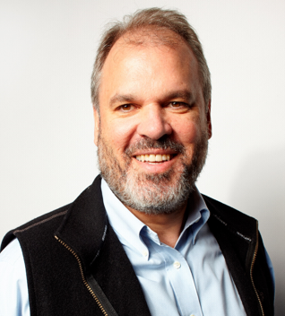
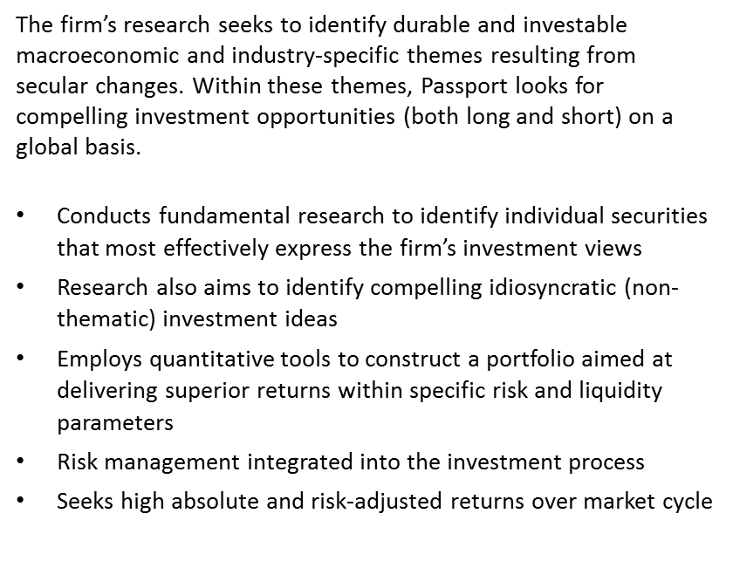
LONG-SHORT EQUITY PASSPORT CAPITAL / BURBANK
Long-Short Equity
Seeks to achieve superior risk-adjusted returns through a combination of macroeconomic analysis, fundamental research, and quantitative tools
Identify durable, secular changes not reflected in asset prices, and asymmetric means of expressing macro and fundamental investment views, both long and short
Risk management is a primary focus, both qualitative and quantitative

Slide 27
LONG-SHORT EQUITY PASSPORT CAPITAL / BURBANK
INVESTMENT PHILOSOPHY
Passport believes:
Global markets do a poor job of discounting important, secular changes that unfold over long periods of time.
By identifying these changes on a global basis, they seek to focus their research on the most compelling sectors and regions for investment.
Through deep, fundamental research, they attempt to identify attractive opportunities to generate alpha.
A rigorous, quantitative approach to portfolio construction and risk management is essential to creating portfolios that aim to achieve certain risk-adjusted return objectives.

Slide 28
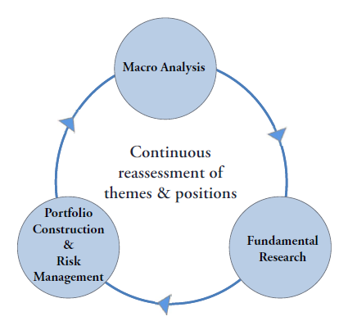
LONG-SHORT EQUITY PASSPORT CAPITAL / BURBANK
INVESTMENT PROCESS
Objectives:
To construct portfolios that aim to deliver superior returns within strategy-specific risk management and liquidity targets.
To identify the most asymmetric means of expressing Passport’s macro and fundamental views.

Slide 29
ARBITRAGE & EVENT DRIVEN STRATEGY WATER ISLAND / ORRICO, MUNN, LOPRETE, FOLTYNOWICZ
Seek long-term returns of at least mid-single digits with low correlations to equity and bond markets, low volatility, and low risk of permanent capital loss
Focus on merger arbitrage, using both equities and bonds or a combination of the two, depending on the team’s assessment of risk-adjusted return potential
Create a portfolio that represents the firm’s highest-conviction merger arbitrage deals based on their assessment of risk-adjusted return potential, with much higher weight to what they believe are the most attractive deals
Also invest in credit and equity “special situations” (restructurings, refinancing, spin-offs, etc.) that offer what they believe are attractive payoffs with limited risk.
Use leverage to a limited extent, but will manage to the same risk guidelines (maximum 1% downside per portfolio level position) including the leverage
Merger arbitrage and other event driven special situations
Global focus across capital structure
Highest-conviction, risk-adjusted ideas
Strict discipline to manage downside risk

Slide 30
ARBITRAGE & EVENT DRIVEN STRATEGY WATER ISLAND / ORRICO, MUNN, LOPRETE, FOLTYNOWICZ
INVESTMENT PROCESS

Slide 31
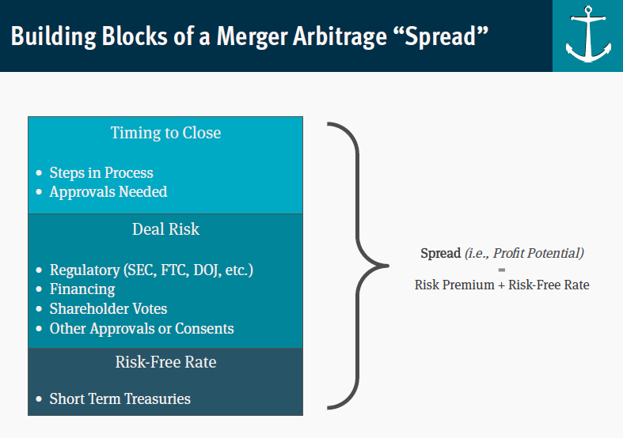
ARBITRAGE & EVENT DRIVEN STRATEGY WATER ISLAND / ORRICO, MUNN, LOPRETE, FOLTYNOWICZ
Building blocks of a merger arbitrage “spread”

Slide 32
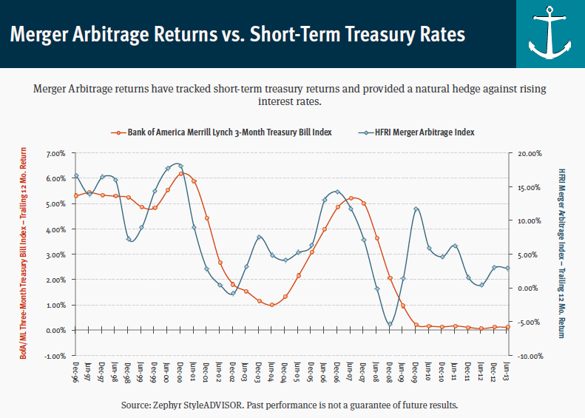
ARBITRAGE & EVENT DRIVEN STRATEGY WATER ISLAND / ORRICO, MUNN, LOPRETE, FOLTYNOWICZ
Merger arbitrage return vs. short-term treasury rates
Source: Zephyr StyleADVISOR as of 6/30/2013. Past performance is not a guarantee of future results.

Slide 33
ALTERNATIVE STRATEGIES FUND PERFORMANCE
SEC 30-Day Yield¹ as of 6/30/16 Institutional: 2.65% Investor: 2.40% Unsubsidized SEC 30-Day Yield² as of 6/30/16 Institutional: 2.57% Investor: 2.33%
^{1.} The 30-day SEC Yield is computed under an SEC standardized formula based on net income earned over the past 30 days. It is a “subsidized” yield, which means it includes contractual expense reimbursements, and it would be lower without those reimbursements.
^{2.} The unsubsidized 30-day SEC Yield is computed under an SEC standardized formula based on net income earned over the past 30 days. It excludes contractual expense reimbursements, resulting in a lower yield.
Expense Ratios | MASFX | MASNX
Inception Date | 9/30/2011 | 9/30/2011
As Of Date | 4/30/2016 | 4/30/2016
Net Expense Ratio (%) Excluding Dividend Expense on Short Sales and Interest & Borrowing Costs on Leverage Line of Credit ³ | 1.49 | 1.74
Total Operating Expenses (%) ⁴ | 1.85 | 2.10
Gross Expense Ratio (%) | 1.94 | 2.18
Performance quoted is for the Institutional share class, represents past performance and does not guarantee future results. The investment return and principal value of an investment will fluctuate so that an investor’s shares, when redeemed, may be worth more or less than their original cost. Current performance of the fund may be lower or higher than the performance quoted. Other share classes may impose other fees. To obtain standardized performance of the funds, and performance as of the most recently completed calendar month, please visit www.mastersfunds.com.
Investment performance reflects fee waivers in effect. In the absence of such waivers, total return would be reduced. For information about other share classes available, please consult the prospectus. Performance of Fund classes will differ. Please see the prospectus for details.
As of June 30, 2016, the Morningstar Multialternative Category average expenses were 3.73% gross and 1.92% net.
^{3.} Does not include dividend expense on short sales of 0.23% and Interest, Commitment Fees and other Borrowing Costs of 0.13%
^{4.} The Advisor is contractually obligated to waive management fees and/or reimburse ordinary operating expenses through April 30, 2017. The total operating expense includes dividend and interest expense on short sales and interest and borrowing costs incurred for investment purposes, which are not included in the expense ratio.

Slide 34
Litman Gregory Masters ALTERNATIVE STRATEGIES FUND
AVERAGE RETURNS / DOWN BOND MARKETS
vs. BARCLAYS AGG
UP / DOWN CAPTURE
vs. BARCLAYS AGG
Negative down capture represents inverse (positive) return.
UP CAPTURE DOWN CAPTURE
All data since fund inception – using monthly returns through 6/30/2016
Past performance is no guarantee of future results

Slide 35
Litman Gregory Masters ALTERNATIVE STRATEGIES FUND
MASFX v. RUSSELL 1000 IN DOWN MARKET WEEKS
 | Average Return in Down Market Weeks
MASFX | -0.26%
Russell 1000 | -1.46%
All data since fund inception – using weekly returns through 6/30/2016
Past performance is no guarantee of future results

Slide 36
ALTERNATIVE STRATEGIES FUND RISK/RETURN STATISTICS
 |  | MASFX | BARCLAYS AGG BOND | Russell 1000 | Morningstar Multi-Alternatives Category
 | Annualized Return | 5.13 | 3.15 | 16.37 | 1.49
 | Total Cumulative Return | 26.81 | 15.86 | 105.48 | 7.27
 | Annualized Std. Deviation | 3.44 | 2.72 | 11.47 | 3.42
 | Sharpe Ratio (Annualized) | 1.45 | 1.13 | 1.38 | 0.43
 | Beta (to Russell 1000) | 0.26 | -0.02 | 1.00 | 0.27
 | Correlation of MASFX to… | 1.00 | -0.15 | 0.79 | 0.82
 | Worst Drawdown | -6.94 | -4.52 | -12.41 | -8.21
 | Worst 12-Month Return | -4.49 | -2.47 | -7.21 | -6.90
 | % Positive 12-Month Periods | 83.67 | 79.59 | 93.88 | 77.55
 | Upside Capture (vs. Russell 1000) | 30.85 | 8.92 | 100.00 | 21.17
 | Downside Capture (vs. Russell 1000) | 28.29 | -10.53 | 100.00 | 41.60
 | Past performance does not guarantee future results Since inception (9/30/11) |  |  |  | As of 6/30/16
 | Worst Drawdown based on weekly returns

